Slide 1

Beijing AIR Quality Forecasting
Kavin Parikh

Slide 2

Introduction
Air pollution is a critical issue affecting public health and environmental sustainability worldwide.
Beijing, as one of the most populous and industrially vibrant cities, faces significant challenges in managing air quality.
Accurate forecasting of air quality plays a pivotal role in proactive mitigation strategies and public health interventions.
Notes:
In this presentation, we delve into the exploration of a few distinct approaches for enhancing Beijing's air quality forecasting

Slide 3

Understanding Beijing's Air Quality Challenges
Beijing, the capital city of China, has experienced rapid industrialization and urbanization over the past few decades.
Consequently, the city faces severe air pollution problems, characterized by high levels of particulate matter (PM2.5), nitrogen dioxide (NO2), sulfur dioxide (SO2), and other pollutants.
Effective air quality management requires reliable forecasting systems to anticipate pollution episodes and implement timely interventions.
Currently, Beijing utilizes various methods for air quality forecasting, including statistical models, numerical simulations, and machine learning techniques.
Notes:
The adverse effects of air pollution on public health are well-documented, including respiratory diseases, cardiovascular problems, and premature mortality.
However, there is a pressing need for more accurate, robust, and efficient forecasting approaches to address the dynamic nature of air pollution in the city.

Slide 4

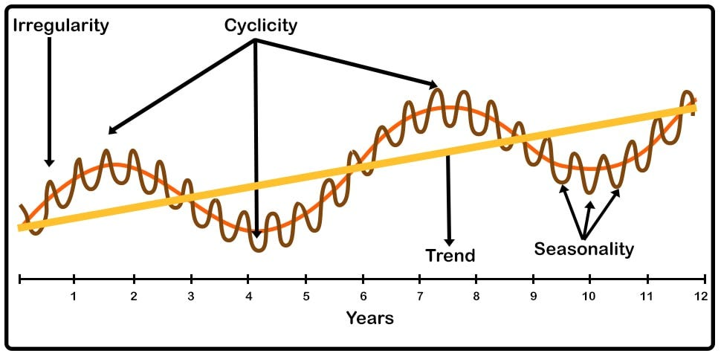
Understanding Cyclical Prediction Methodology
Cyclical prediction is a forecasting technique that leverages the cyclical nature of time-series data, such as daily, weekly, or seasonal patterns.
Historical air quality and meteorological data are analyzed to identify recurring cycles and trends.
Time-series decomposition methods, such as seasonal decomposition of time series (STL) or Fourier analysis, are commonly used to extract cyclical components.
Notes:
Key advantages of the cyclical prediction approach include its ability to capture periodic variations in air quality and its suitability for short to medium-term forecasting tasks.

Slide 5

Understanding Regression Prediction Methodology
Regression prediction involves modeling the relationship between air quality and various predictor variables using regression techniques.
Predictor variables may include meteorological parameters (e.g., temperature, humidity, wind speed), geographical features, time of day, and historical air quality data.
Regression models, such as linear regression, polynomial regression, and ridge regression, are trained on historical data to learn the relationship between predictors and air quality.
The trained models are then used to make predictions for future air quality conditions based on new input data.

Slide 6
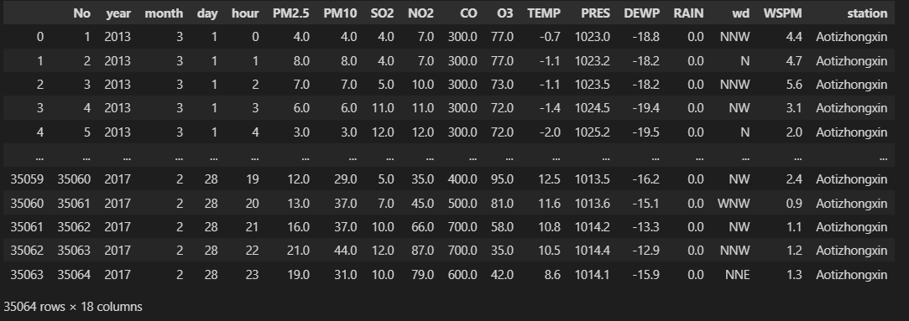
Data Collection
The dataset comprises hourly air quality and meteorological data collected from 2013 to 2017 in Beijing.
Variables include PM2.5, PM10, SO2, NO2, CO, O3, temperature (TEMP), pressure (PRES), dew point temperature (DEWP), rainfall (RAIN), wind direction (wd), and wind speed (WSPM), among others.
Each row represents a unique observation at a specific date and time, recorded at various monitoring stations across Beijing.

Slide 7
Data Preprocessing

